Slide 1
Overview HTML, CSS and JS

Slide 2
Introduction to client side programming
HTML
CSS
JS
Client Side
HTML → Structure and Content
CSS → Presentation
JavaScript → Behaviour (dynamic stuff)

Slide 3
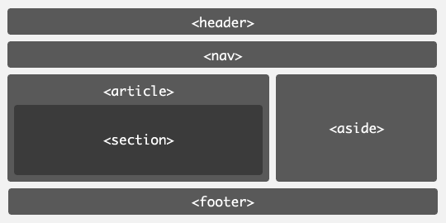
HTML
HTML is a mark-up language for structuring and presenting content for the World Wide Web.
HTML5 is the fifth version of HTML standard of the W3C (World Wide Web Consortium).
The aim of HTML5 is to improve the language by supporting latest multimedia while keeping it user friendly and easily readable by humans and understood by bots and parsers.

Slide 4
Why is HTML5 trending ?
Legacy/Cross Browser Support
Support for Mobile/tablet sites and apps
Better Interactions / Dynamic websites
Cleaner Code
Video/Audio support
Accessibility
A simpler way to DOCTYPE declaration: <!DOCTYPE html>

Slide 5
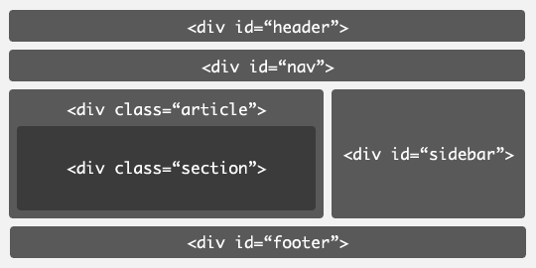
HTML5 Semantic Tags
A semantic tag clearly describes its meaning to both the browser and the developer.
<main>
<mark>
<figcaption>
<figure>
<details>
<summary>
<header>
<article>
<nav>
<section>
<aside>
<footer>

Slide 6
HTML5 Form Inputs and attributes
Email
Date
Range
Search
Tel
Color
Number
x-webkit-speech
Example:

Slide 7
HTML5 Multimedia elements (Audio/Video)
<video> tag
Src
Autoplay
Controls
Loop
<audio> tag
Src
Autoplay
Controls
Loop

Slide 8
HTML5 scripting API’s
HTML5 also defines several scripting APIs that you can use with CSS3 and JavaScript. Below are just a few of them:
Geolocation
Drag and Drop
Offline capabilities (Local Storage, Session Storage, IndexedDB)
Canvas and SVG
User Media (Camera and microphone)
Web Workers

Slide 9
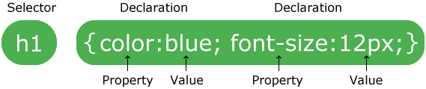
CSS
Cascading Style Sheet (CSS) are set of rules that describe how HTML elements should be displayed.
Few Examples:
https://codepen.io/Michiel/pen/OPPKMr
https://codepen.io/bosworthco/pen/YWBLpR
https://codepen.io/zitrusfrisch/pen/fjbal
https://css-tricks.com/examples/MovingHighlight/
https://codepen.io/yemon/pen/YrPmQr

Slide 10
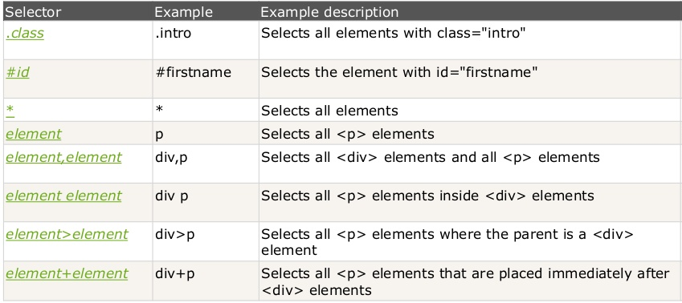
CSS - Selectors
Complete reference: https://www.w3schools.com/cssref/css_selectors.asp

Slide 11
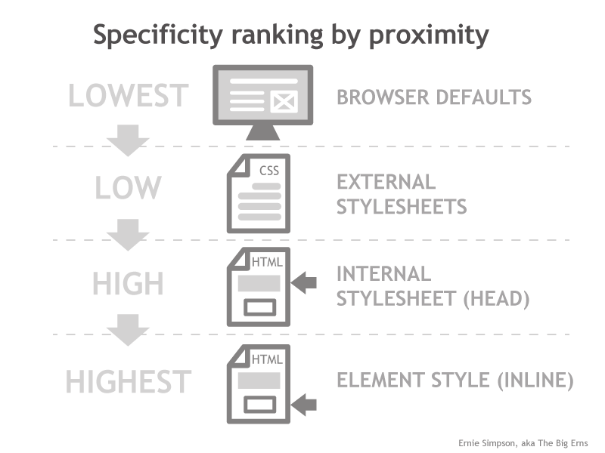
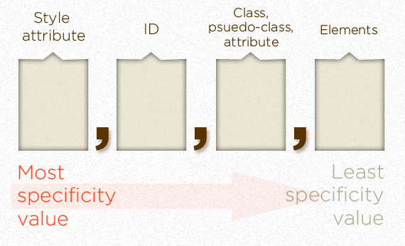
CSS – Specificity and Cascade

Slide 12
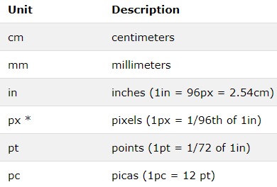
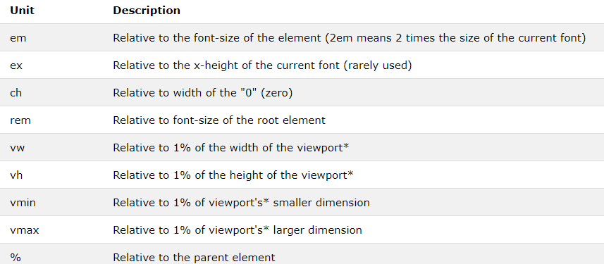
CSS – Units
Absolute
Relative

Slide 13
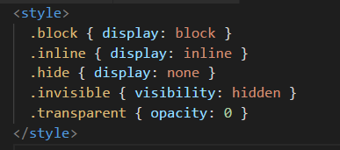
CSS – Layout – Display Type
s
block makes a box
inline runs like text
display: none removes from layout
visibility: hidden renders only dimensions
opacity: 0 just makes it transparent.

Slide 14
What’s new in CSS3
Transformations
Translate
Rotate
Skew
Transitions
Animations
Responsiveness
Media Queries
Multi Column Layout

Slide 15
CSS - Best Practices
Prefer classes selector over id selectors.
Avoid attaching classes to element type selectors.
Avoid !important.
Always use vendor prefixes. Put plain property last.
Provide for a fallback experience.
Use CSS Lint (http://csslint.net/)

Slide 16
JavaScript
Quick History
Created in 1995 by Brendan Eich for Netscape in just 10 days.
Formal spec name: ECMAScript
ES3 supported across all browsers
ES4 was a mess, never got implemented
ES5 is the latest edition, supported by all modern browsers

Slide 17
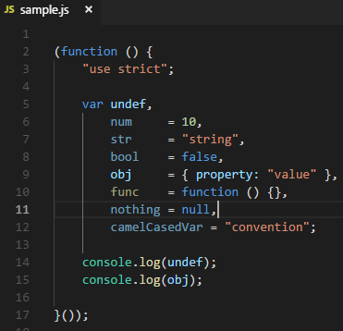
JavaScript – Variables and Scope
Default value for unassigned variable is undefined.
Variable scope is simply the function scope, not block scope.
Datatypes can be changed at runtime.

Slide 18
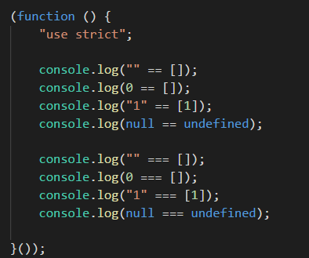
JavaScript – Equality Checking
Never use ==, or !=, Always use ===, or !==

Slide 19
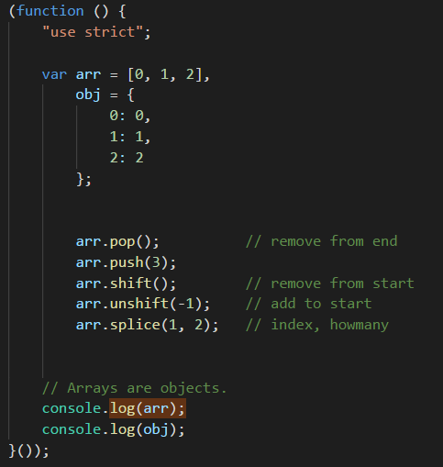
JavaScript – Arrays and Objects

Slide 20
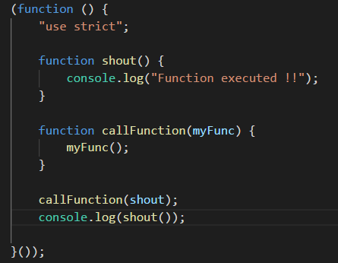
JavaScript – Functions
Functions are First-Class citizens. Functions can be passed as parameters to and returned as result from other functions just like variable.
IIFE (Immediately Invoked Function Expression)
Self-executing anonymous function
Protect against polluting the global environment
Retaining privacy for variables defined within function
All functions return a value (undefined by default)

Slide 21
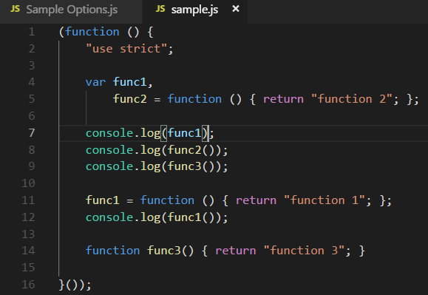
JavaScript – Functions Hoisting
Function declarations get hoisted, at the top of scope.

Slide 22
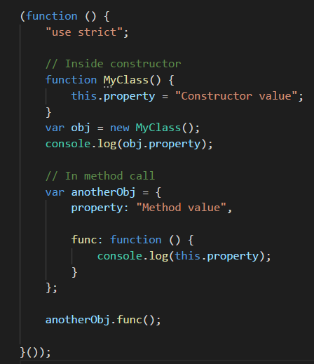
JavaScript – “this” keyword
In a constructor, this is the object being created.
In a function called as method on an object, this is the object itself.
Without strict mode, function call has this set to window.

Slide 23
Developer handbook for best practices.

Slide 24
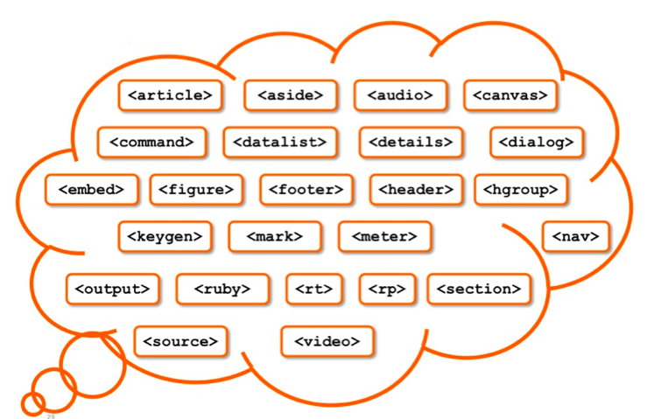

Thank you!!

